Slide 1
Let’s Talk About Sex!
Bradley Plantin, RN
West Virginia State University

Slide 2
Reflection
If you want a hard life, have easy conversations.
If you want an easy life, have hard conversations!

Slide 3


1. Agenda
Let’s Talk About Sex Education
Dr. Olivia Richman.
Listening Circle
An intimate conversation with adults living with STD’s STI’s and Discussion with Kanawha Valley Health Department
Break Out Groups
From Theory to Praxis. How to live a healthy and safe sex life. WVSU College Counseling Service

Slide 4

Dr. Olivia Richman-Let's Talk About Sex Education
Dr. Olivia Richman
Is a physician and industry leader in discussing why its important to socialize and normalize talking about sex.

Slide 5
2. Listening Circle
An intimate portrait and discussion with people living with Unplanned Pregnancy and STD’s STI’s and Kanawha Charleston Health Department.
Unplanned Pregnancy
Brenda Jenkins
HIV
Bernard Shanks.
HPV
Lucy Phillips.
Herpes
Brandon Brown.
STI Prevalence and Safe Sex Practices
Kanawha Charleston Health Department

Slide 6
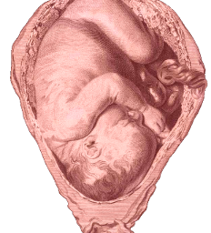
Unplanned Pregnancy
Pregnancy and birth are significant contributors to high school dropout rates among girls. Only about 50% of teen mothers receive a high school diploma by 22 years of age, whereas approximately 90% of women who do not give birth during adolescence graduate from high school.
The children of teenage mothers are more likely to have lower school achievement and to drop out of high school, have more health problems, be incarcerated at some time during adolescence, give birth as a teenager, and face unemployment as a young adult.
Centers for Disease Control https://www.cdc.gov/teen pregnancy/about/

Slide 7
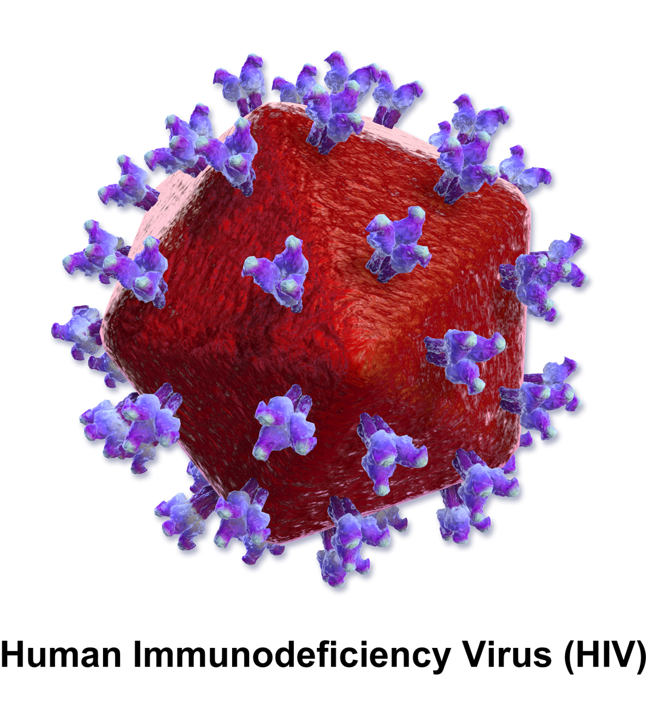
The only 100% effective way to avoid STDs is to not have vaginal, anal, or oral sex. If you are sexually active, you can do the following things to lower your chances of getting STDs and HIV:
Choose less risky sex activities;
Use a new condom, consistently and correctly, for every act of vaginal, anal, and oral sex throughout the entire sex act (from start to finish);
Reduce the number of people with whom you have sex;
Limit or eliminate drug and alcohol use before and during sex;
Have an honest and open talk with your healthcare provider and ask whether you should be tested for STDs and HIV;
Talk to your healthcare provider and find out if either pre-exposure prophylaxis, or PrEP, or post-exposure prophylaxis, or PEP, is a good option for you to prevent HIV infection.
Centers for Disease Control https://www.cdc.gov/std/hiv/stdfact-std-hiv.htm

Slide 8
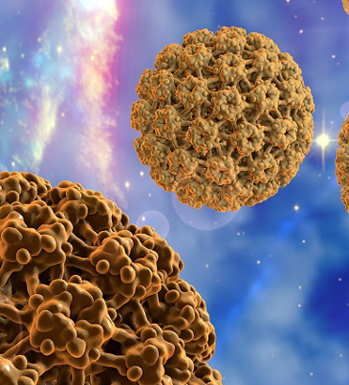
Based on data from 2015 to 2019, about 47,199 new HPV-associated cancers occur in the United States each year: 26,177 among women, and 21,022 among men. Cervical cancer is the most common HPV-associated cancer among women, and oropharyngeal cancers (cancers of the back of the throat, including the base of the tongue and tonsils) are the most common among men.
In general, HPV is thought to be responsible for more than 90% of anal and cervical cancers, about 70% of vaginal and vulvar cancers, and more than 60% of penile cancers. Oropharyngeal cancers traditionally have been caused by tobacco and alcohol, but recent studies show that about 70% of cancers of the oropharynx may be linked to HPV. Many cancers of the oropharynx may be caused by a combination of tobacco, alcohol, and HPV.
Centers for Disease Control https://www.cdc.gov/cancer/hpv/statistics/

Slide 9
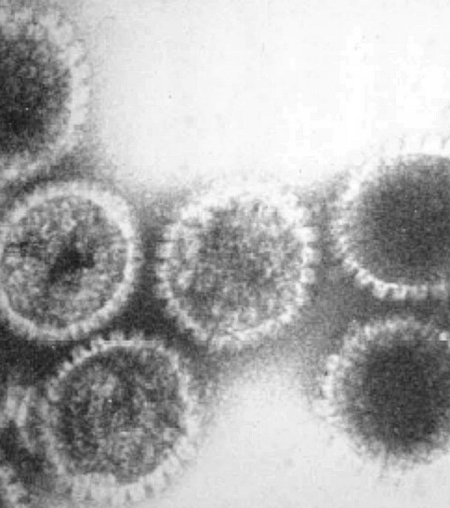
How can I prevent genital herpes?
The only way to completely avoid STDs is to not have vaginal, anal, or oral sex.
If you are sexually active, you can do the following things to lower your chances of getting genital herpes:
Being in a long-term mutually monogamous relationship with a partner who does not have herpes.
Using condoms the right way every time you have sex.
Be aware that not all herpes sores occur in areas that a condom can cover. Also, the skin can release the virus (shed) from areas that do not have a visible herpes sore. For these reasons, condoms may not fully protect you from getting herpes.
If your sex partner(s) has/have genital herpes, you can lower your risk of getting it if:
Your partner takes an anti-herpes medicine every day. This is something your partner should discuss with his or her healthcare provider.
You avoid having vaginal, anal, or oral sex when your partner has herpes symptoms (i.e., during an “outbreak”).
Centers for Disease Control https://www.cdc.gov/std/herpes/stdfact-herpes.htm

Slide 10
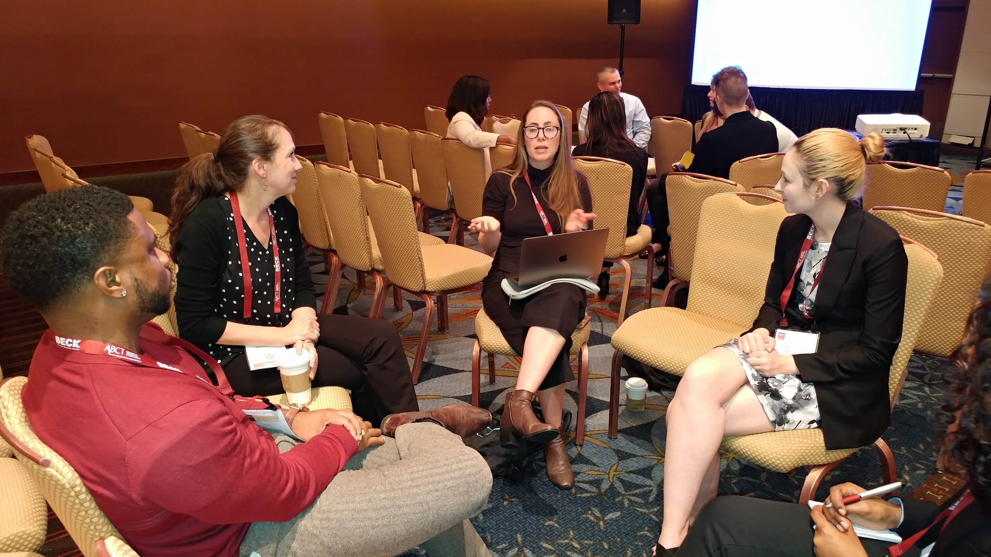
Break Out Groups
WVSU Counseling Center
There are several break out groups in private rooms. These groups are based on gender identity and sexual orientation. Please find your way to the room of your choice.

Slide 11
3. Resources
.
WVSU Counseling Services
https://www.wvstateu.edu/current-students/counseling-and-accessibility-services.aspx
Kanawha Charleston Health Department
https://www.kchdwv.org/
Dr. Olivia Richman
https://www.droliviarichman.com/
Centers For Disease Control
https://www.cdc.gov/

